Slide 1
故事七步驟--自我介紹
(nizima live)
Notes:
大家好，接下來我會用故事七步驟來介紹我自己

Slide 2
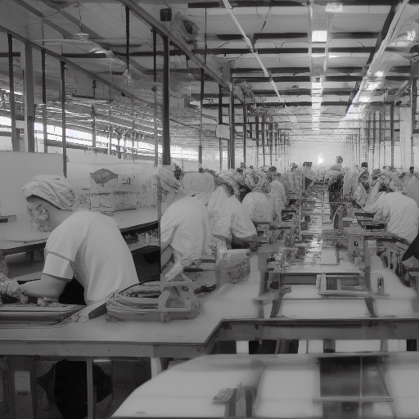

目標
Notes:
Anime style. A girl was born in a factory with tons of replica. She has long black hair tied into twin tails with a blue ribbon. She wears a black bunny ears headdress with a pink bow. Her eyes were large and bright pink with a slight blush and twinkle. Her nose is small and delicate, her lips are pink, her skin is fair, and she wears star-shaped earrings on her ears. She wore a white and blue dress with a red and white pattern. The dress has a deep V-neck neckline, long sleeves with white cuffs, and white lace gloves on the wrists. She also wore black pantyhose and blue heels that were decorated with a red chevron pattern.
我是薇薇塔Vivetta，出生於2099年，由業界頂尖的Vofan老師與Red soda老師製造出來的量產型貓耳妖精，
希望有一天能夠逃脫暗無天日的工廠，去大公司當個聽說現在很紅的vtuber??海撈一筆!

Slide 3

阻礙
Notes:
Anime style. during the process of escaping, a girl was repeatedly caught, sad scene. She has long black hair tied into twin tails with a blue ribbon. She wears a black bunny ears headdress with a pink bow. Her eyes were large and bright pink with a slight blush and twinkle. Her nose is small and delicate, her lips are pink, her skin is fair, and she wears star-shaped earrings on her ears. She wore a white and blue dress with a red and white pattern. The dress has a deep V-neck neckline, long sleeves with white cuffs, and white lace gloves on the wrists. She also wore black pantyhose and blue heels that were decorated with a red chevron pattern.
但是在逃脫過程中一再重複被抓到、送回去洗掉記憶與情感的過程，導致我的身體有些瑕疵或不協調!

Slide 4
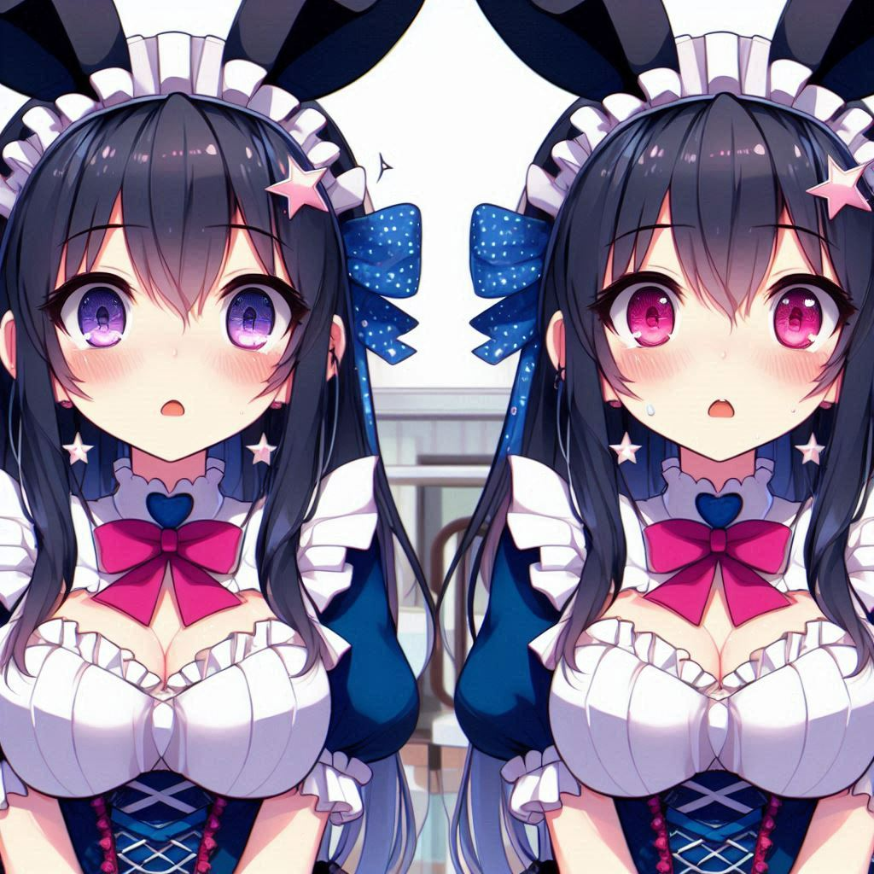
努力
Notes:
Anime style. a girl who managed to survive in a factory She has long black hair tied into twin tails with a blue ribbon. She wears a black bunny ears headdress with a pink bow. Her eyes were large and bright pink with a slight blush and twinkle. Her nose is small and delicate, her lips are pink, her skin is fair, and she wears star-shaped earrings on her ears. She wore a white and blue dress with a red and white pattern. The dress has a deep V-neck neckline, long sleeves with white cuffs, and white lace gloves on the wrists. She also wore black pantyhose and blue heels that were decorated with a red chevron pattern.
就算這樣，我依舊靠著頑強的毅力，硬是撐過了每場的「洗心革面」，保住了人格與夢想

Slide 5

結果
Notes:
Anime style. Nervous scene. a girl who successfully survive. Her face is full of dirt and scar.She has long black hair tied into twin tails with a blue ribbon. She wears a black bunny ears headdress with a pink bow. Her eyes were large and bright pink with a slight blush and twinkle. Her nose is small and delicate, her lips are pink, her skin is fair, and she wears star-shaped earrings on her ears. She wore a white and blue dress with a red and white pattern. The dress has a deep V-neck neckline, long sleeves with white cuffs, and white lace gloves on the wrists. She also wore black pantyhose and blue heels that were decorated with a red chevron pattern.
在各種極限拉扯與掙扎中，我終於逃出生天，離自己的夢想邁出了一大步!

Slide 6
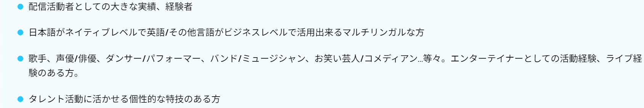
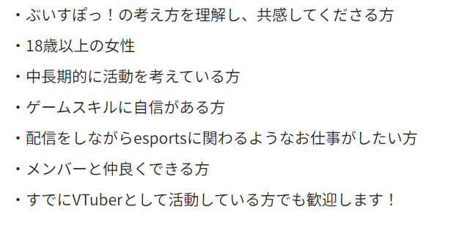
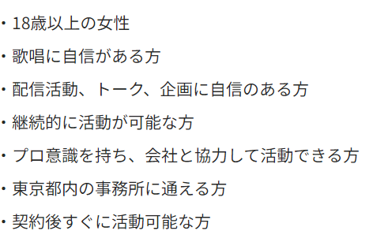
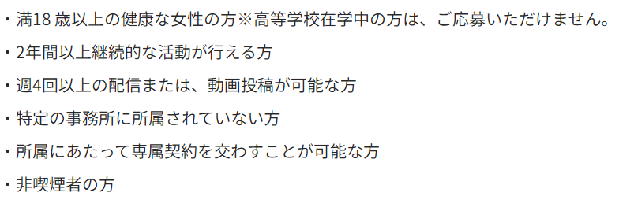
意外
Notes:
然而，查了網路上各大公司的要求後，卻發現各公司基本都要求要是成年女性，並且擁有一項特別的技能，像是影片剪輯、唱歌、遊戲等等

Slide 7

轉彎
Notes:
Anime style. happy scene.a streamer girl who holds a micr andstreams happily in a room. portrait size is a quarter of the canvas.She has long black hair tied into twin tails with a blue ribbon. She wears a black bunny ears headdress with a pink bow. Her eyes were large and bright pink with a slight blush and twinkle. Her nose is small and delicate, her lips are pink, her skin is fair, and she wears star-shaped earrings on her ears. She wore a white and blue dress with a red and white pattern. The dress has a deep V-neck neckline, long sleeves with white cuffs, and white lace gloves on the wrists. She also wore black pantyhose and blue heels that were decorated with a red chevron pattern.
不過，我轉念一想，何不自己開台呢? 還不會受到事務所的束縛與限制!

Slide 8
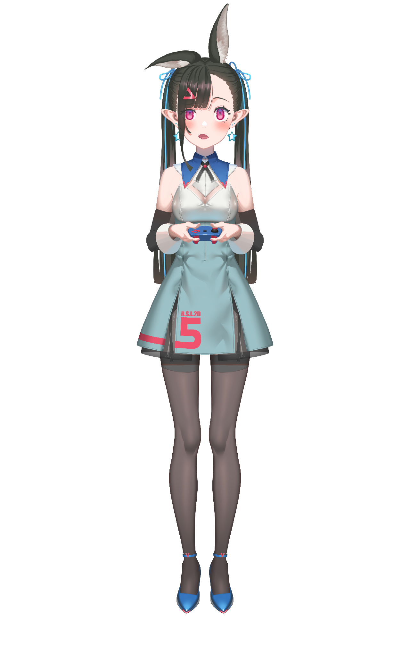
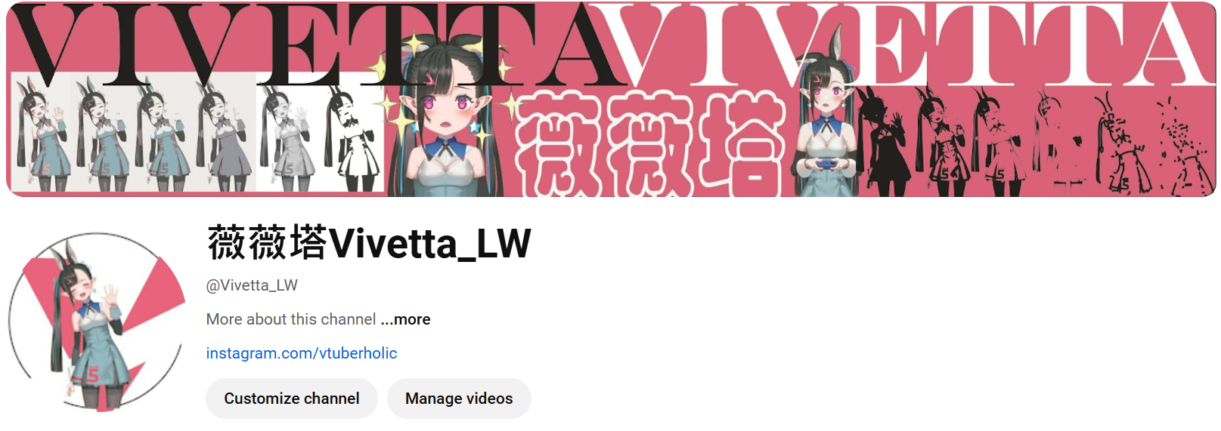
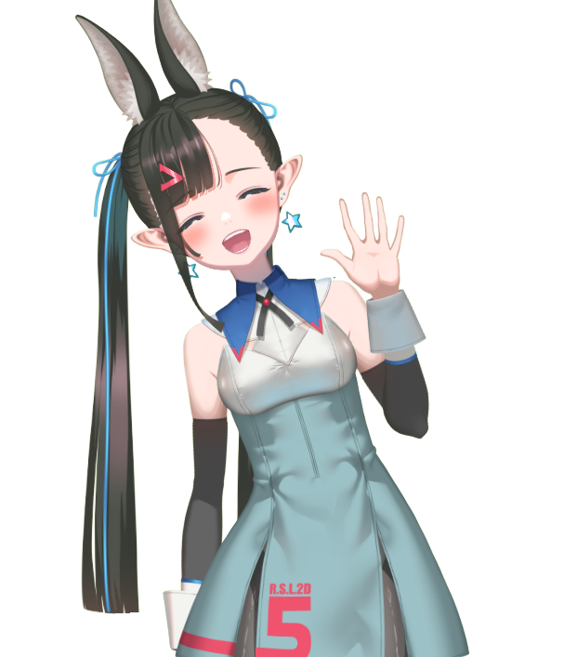
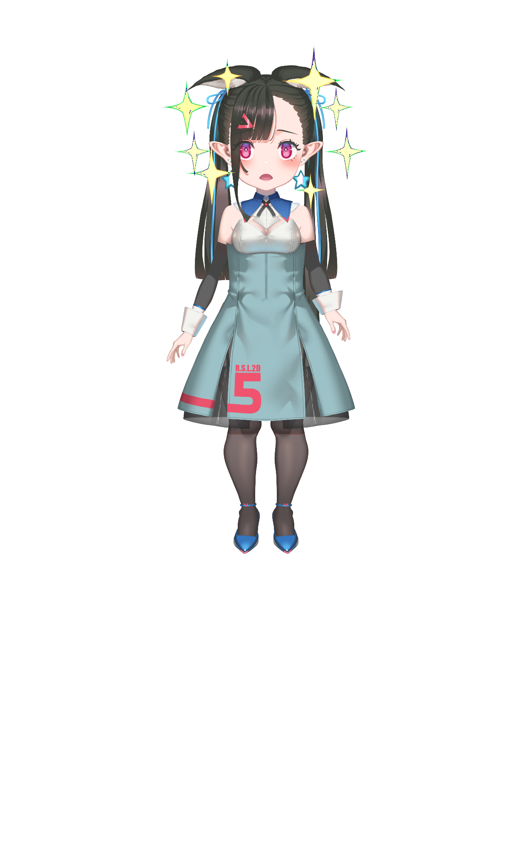
結局
Notes:
因此，我開設了自己的頻道：薇薇塔 ! 再請大家多多支持~
(LW其實是以前工廠裡我的代號

Slide 9
Notes:
薇薇塔PROMPT：一位女性，有著黑色長髮，用藍色的絲帶紮成雙馬尾。她戴著黑色的兔子耳朵頭飾，頭飾上有粉紅色的蝴蝶結。她的眼睛很大，是明亮的粉紅色，帶著一點紅暈和閃爍。她的鼻子小巧而精緻，嘴唇是粉紅色的，皮膚白皙，耳朵上戴著星形的耳環。她穿著一件白色和藍色的連身裙，帶有一個紅色和白色的圖案。洋裝的領口是深V領，袖子是長袖，袖口是白色的，手腕戴著白色的蕾絲手套。她還穿著黑色的褲襪和藍色的高跟鞋，鞋子上裝飾著紅色的 V 形圖案。

Slide 10
Notes:
我是薇薇塔Vivetta，出生於2099年，由業界頂尖的Vofan老師與Red soda老師製造出來的量產型貓耳妖精，
希望有一天能夠逃脫暗無天日的工廠，去大公司當個聽說現在很紅的vtuber??海撈一筆!
但是在逃脫過程中一再重複被抓到、送回去洗掉記憶與情感的過程，導致我的身體有些瑕疵或不協調!
就算這樣，我依舊靠著頑強的毅力，硬是撐過了每場的「洗心革面」，保住了人格與夢想
在各種極限拉扯與掙扎中，我終於逃出生天，離自己的夢想邁出了一大步!
然而，查了網路上各大公司的要求後，卻發現各公司基本都要求要是成年女性，並且擁有一項特別的技能，像是影片剪輯、唱歌、遊戲等等
不過，我轉念一想，何不自己開台呢? 還不會受到事務所的束縛與限制!
因此，我開設了自己的頻道：薇薇塔 ! 再請大家多多支持~
(LW是以前工廠裡我的代號

